Slide 1

Data 602 Project
Proposal
01.21.25
Gautham Nagaraj Chandra Shekariah
Romith Bodanda
Lamis

Slide 2

The data
from IEEE Dataport

Slide 3
Forming a Hypothesis
Science Presentation
Why this dataset?
The dataset is uploaded to IEEE-dataport which allows the public to use the data
The dataset does not contain any information regarding the patient, like the name or complete address; thus, upholding the law of data privacy
The columns of the data set contain medical terminologies which cannot be understood by layman; It will be up to the project group to research and explain these terms, which will better our understanding

Slide 4

Question
Forming a Hypothesis
=
Insight

Slide 5
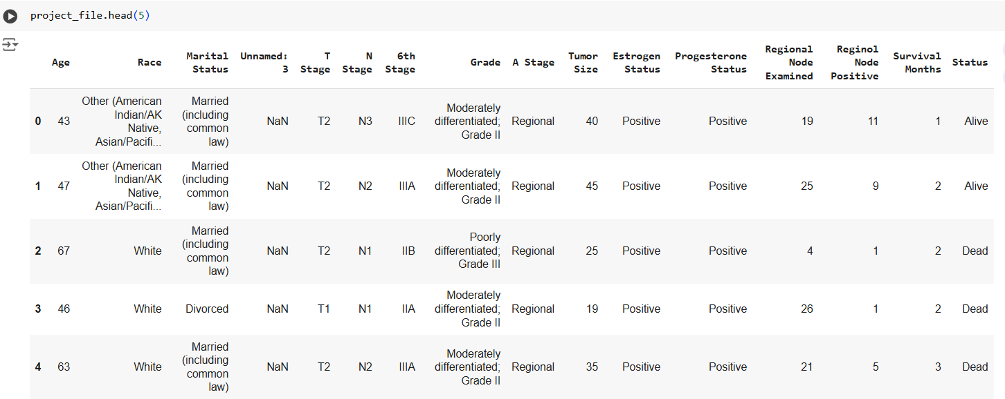
Outlook on the data

Slide 6

Summary
Drawing a Conclusion
Science Presentation
The data visualization will be done, again, based on the guiding questions
We should be able to visualize what the impact of each column is on the patient’s survival chances
The results obtained from this project may help clear some common misconceptions around the disease

